Slide 1
CAPSTONE PROJECT
Secure Data Hiding in Image Using Steganography
Presented By
Student Name : Rugved Kulkarni
College Name & Department : University of Portsmouth

Slide 2
OUTLINE
Problem Statement
Technology used
Wow factor
End users
Result
Conclusion
Git-hub Link
Future scope

Slide 3
Problem Statement
The task is to securely embed sensitive information within an image through steganography to maintain confidentiality and prevent unauthorized access. Unlike conventional encryption, which can draw attention to concealed data, steganography subtly integrates the data into the image’s pixels without visibly altering it. The core challenge is to design a robust algorithm that can both insert and retrieve data while preserving the image’s quality and ensuring its security.

Slide 4
Technology used
Libraries and Modules
Standard Modules: Built-in modules such as os, sys, and string
Custom Module: steganography.py
Development Environment
Operating System: Windows
Interpreter: Python (IDLE)
Supported File Format: BMP (Bitmap Image)
Key Details
Steganography Technique: Least Significant Bit (LSB) encoding
Data Handling: Embeds and extracts text data from images while preserving image quality

Slide 5
Wow factors
LSB Steganography: Embeds data into the least significant bits, securing sensitive information without causing visible changes to the image.
Lossless BMP Handling: Operates on uncompressed BMP images, ensuring complete data integrity.
Efficient & Lightweight: Developed in C for superior performance, it outpaces comparable tools built in Python or Java.
User-Friendly CLI: Features an intuitive command-line interface that simplifies data embedding and extraction, making it ideal for automation.

Slide 6
End users
Cybersecurity Specialists – Leverage steganography for secure data exchange and covert communications.
Digital Forensics Experts – Retrieve concealed information from images during digital investigations.
Government & Defence Agencies – Employ steganographic techniques to embed sensitive data in images for intelligence and confidential operations.
Researchers & Academics – Analyse and enhance steganographic methods to advance data security and cryptographic research.
Privacy-Conscious Individuals – Use steganography to protect personal or confidential information from unauthorized access.

Slide 7
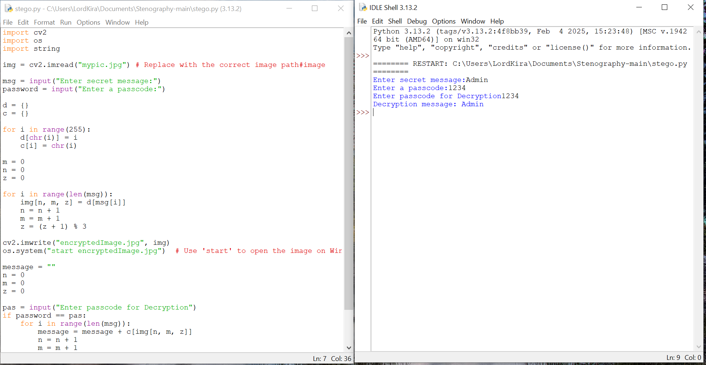
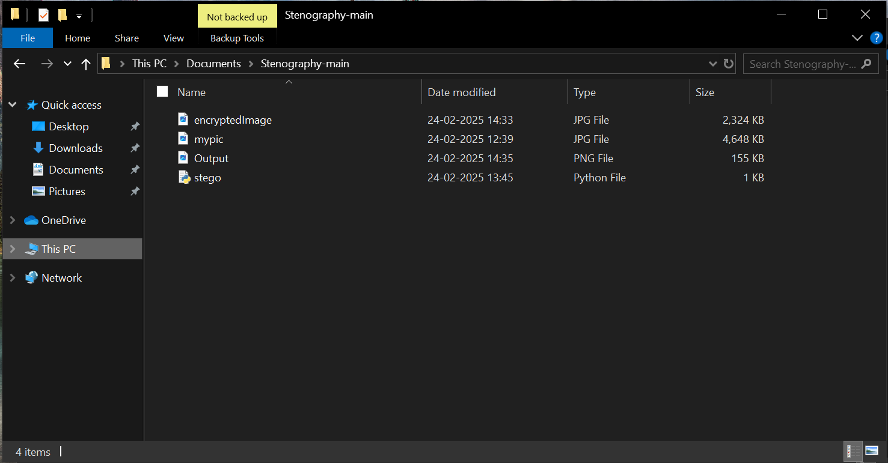
Results

Slide 8
Conclusion
This project effectively tackles the challenge of covertly embedding data within an image through LSB-based steganography. By altering the least significant bit of pixel values in BMP images, it hides sensitive information without any noticeable visual changes. The solution preserves data integrity, operates efficiently with minimal dependencies, and features a straightforward CLI for both embedding and extracting data.
Although the current version supports only BMP files, it can be expanded to accommodate other formats like PNG or employ DCT-based techniques for JPEG images. Overall, this project provides a lightweight, fast, and secure method for ensuring data confidentiality, making it highly valuable for cybersecurity, forensic analysis, and private communication.

Slide 9
GitHub Link
https://github.com/Rugved1/Stegnography-Project/tree/main

Slide 10
Future scope(optional)
Live Preview: Instantly display the image both before and after applying steganography.
Customization Features: Fine-tune the encoding process by adjusting settings such as bit depth.
Drag-and-Drop Support: Easily add images and messages through a simple drag-and-drop interface.
Graphical User Interface (GUI): Enjoy an intuitive, user-friendly interface that simplifies the embedding and extraction of messages.

Slide 11
THANK YOU

